Slide 1
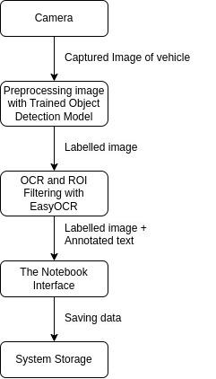
Overview
Automatic Number Plate Detection & Recognition system that utilizes TensorFlow for license plate detection and EasyOCR for character recognition. This software can be used to detect and recognize license plates in images as well as live videos with high accuracy and speed and then save the information for future use.

Slide 2
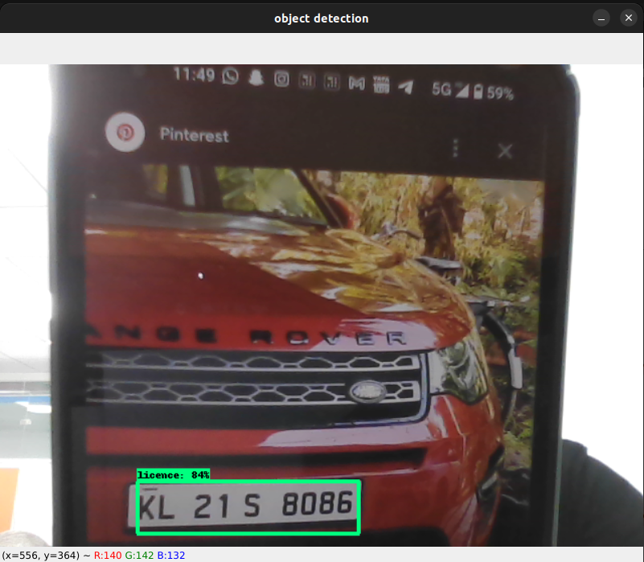
Working - step 1
Number Plate detection using Tensorflow :
Training of ML models is done on a kaggle dataset. Training Dataset has 410 images and 410 XML file and testing set has 22 image. Also and tests on the validation images input by user and comparing it.
NB: The model has been trained before all the steps even started.
The labelled image as output:

Slide 3
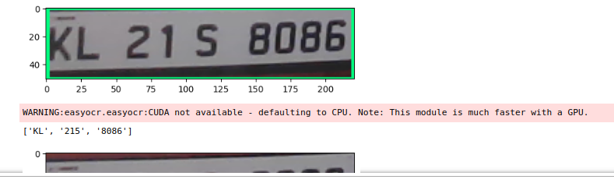
Working - step 2
Character identification Using EasyOCR :
This step include filtration of detected image from STEP-1 and apply OCR and ROI filtering.
ROI - region of interest
OCR - optical character Recognisation
The labelled image as output:

Slide 4
Future Aspects
A large complex training dataset can be used for better results and currently this model offer approx. 90% accuracy.
Training on a specific dataset to detect a particular kind of number plate.
ANPDR system may be integrated with other technologies, such as CCTV cameras or GPS tracking system, to provide even more detailed information about vehicle movements and location.
ANPDR systems may move to cloud-based architectures, where images and data are stored and processed remotely. This would allow for easier scalability and more flexible deployment options.

Slide 5
Thank You
Shubham Singh

